Slide 1
www.concoct.com/login
Concoct
Login
username
password
LOGIN
REGISTER

Slide 2
Concoct
www.concoct.com/main
Concoct
Add a Drink
Your Likes
Add your drink ingredients
Lime Juice
Ingredient 2…
Ingredient 3…
Pick a taste profile
FIND ME A DRINK !

Slide 3
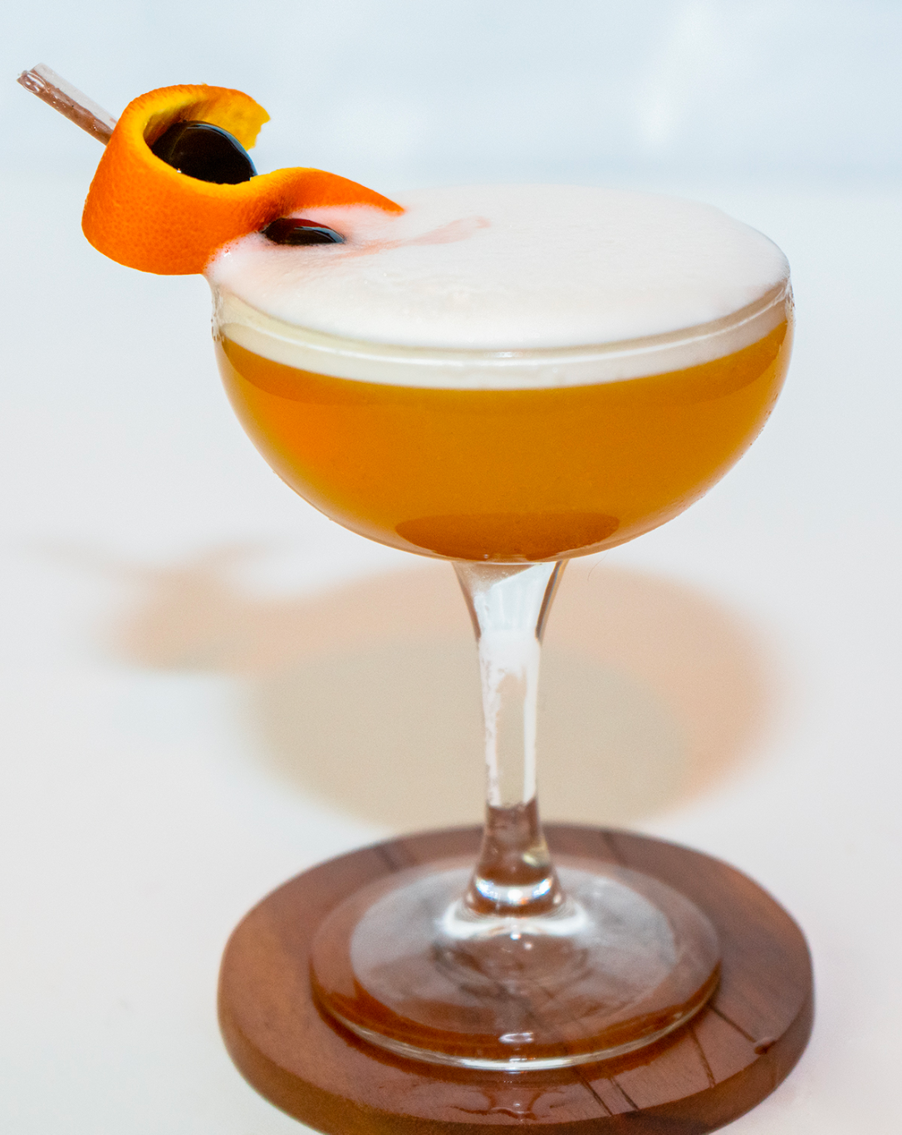
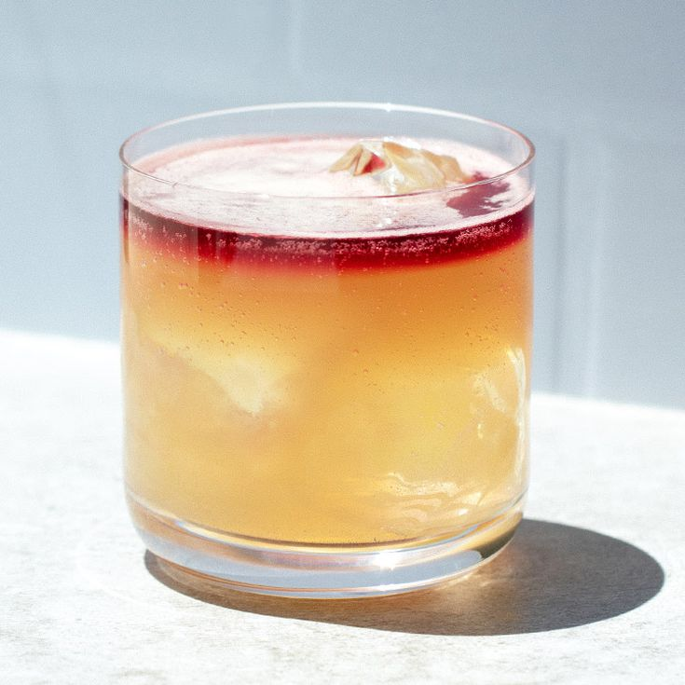
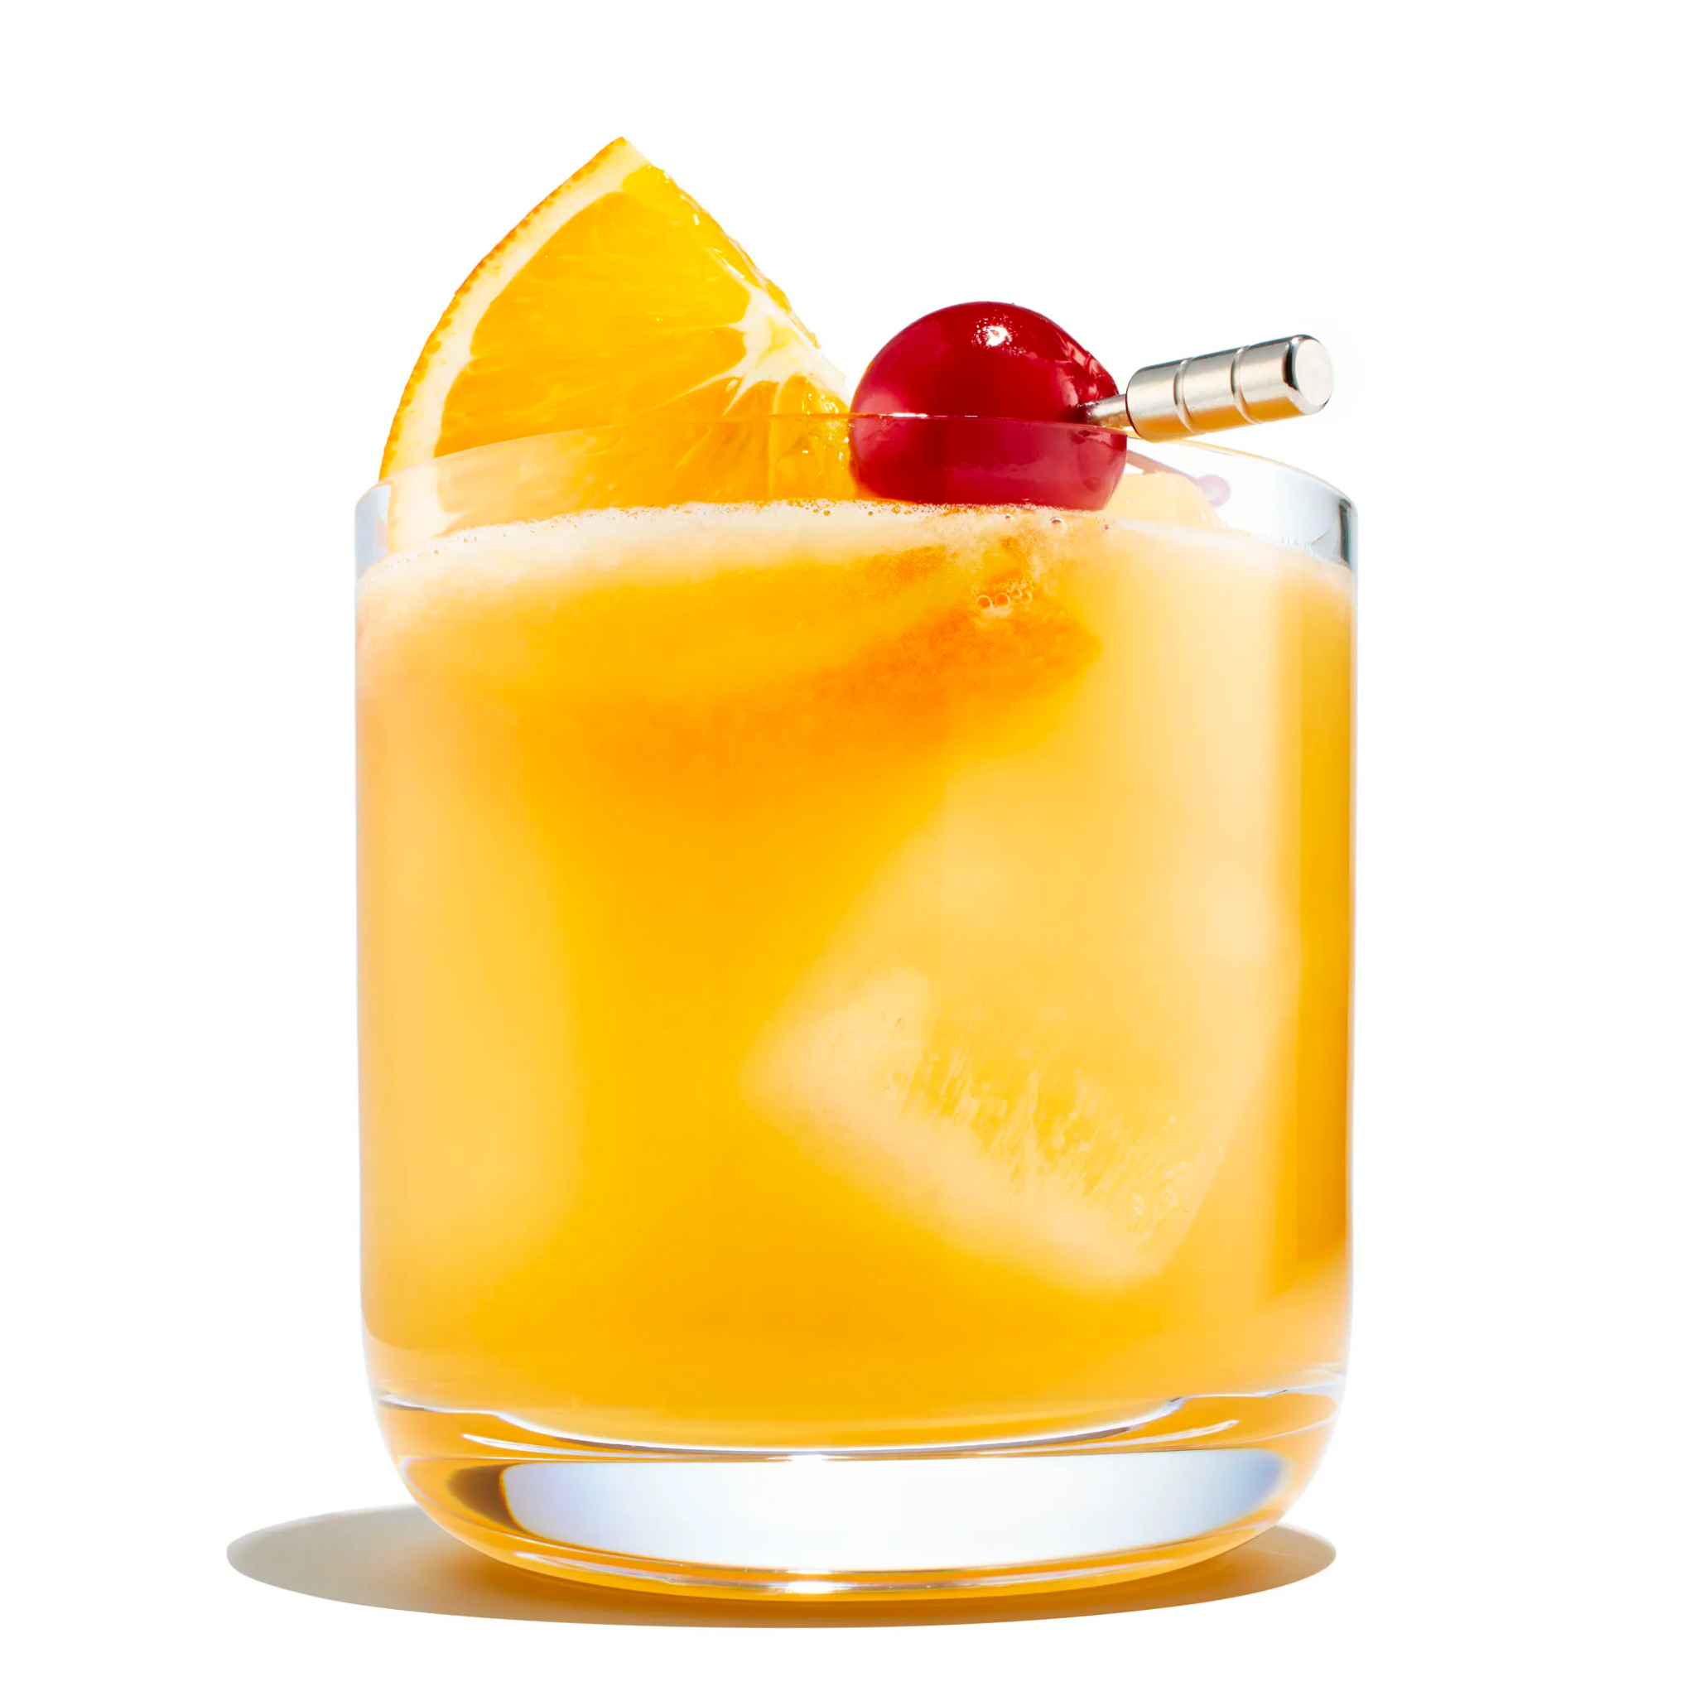
www.concoct.com/results
Concoct
Results:
Lime Juice
Sugar Syrup
Egg Whites
Bourbon
Sour
Boston Sour
Whiskey Sour
New York Sour

Slide 4
www.concoct.com/user-likes
Concoct
Find a Drink
Add a Drink
Dev’s Likes:
Boston Sour
New York Sour

Slide 5
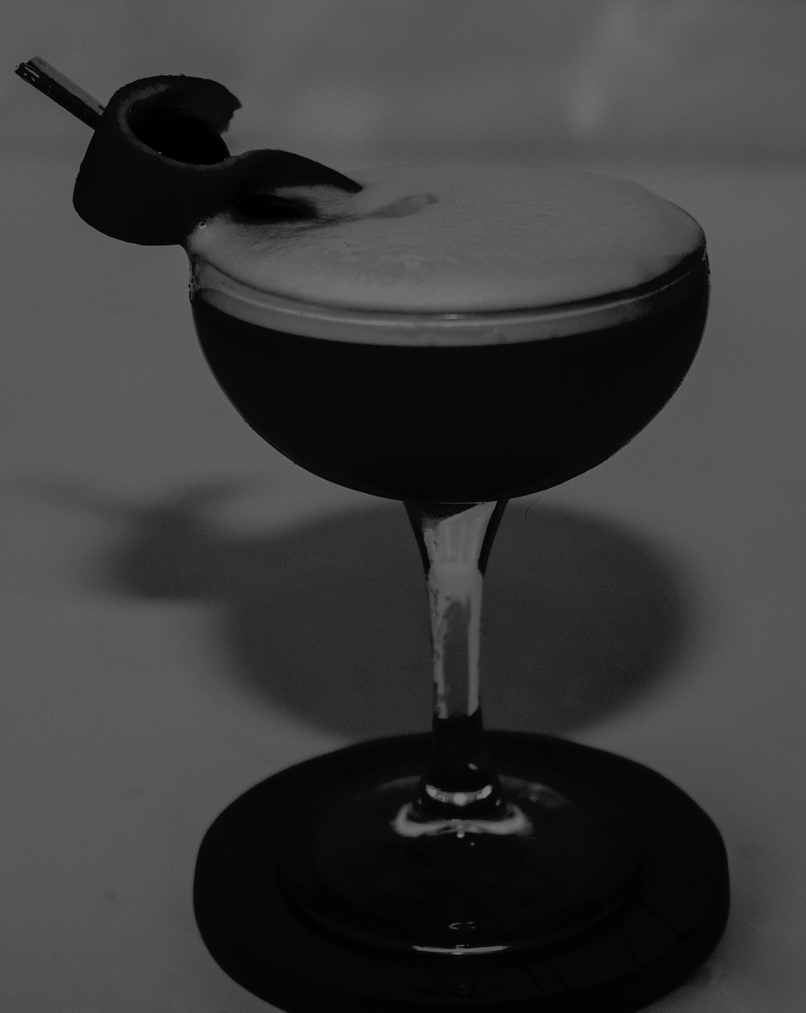
www.concoct.com/user-add
Concoct
Find a Drink
Your Likes
Add a Drink:
Ingredients
Recipe
Lime Juice
Type recipe here…
Ingredient 2…
Ingredient 3…
Add Picture
Ingredient 4…
Name
Ingredient 5…
Add +

